Slide 1

Versatile 3D Avatar Technology for
Enhanced Educational Experiences.
Proposal for HRI – RINF TECH Cooperation
www.rinftech.com

Slide 2

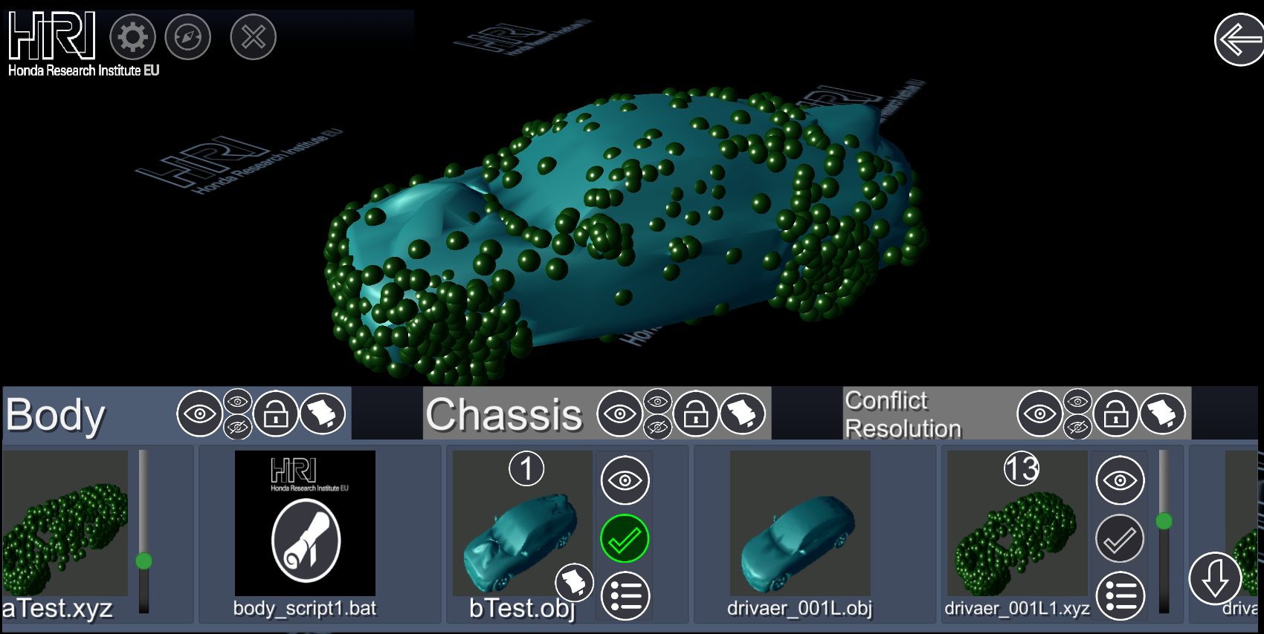
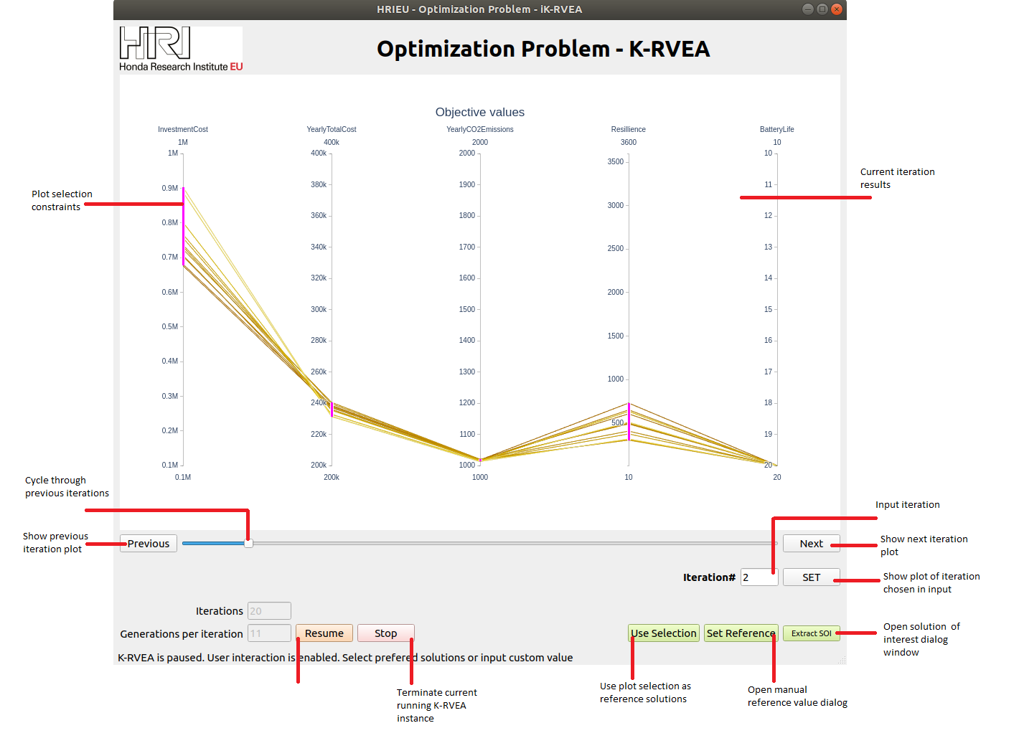
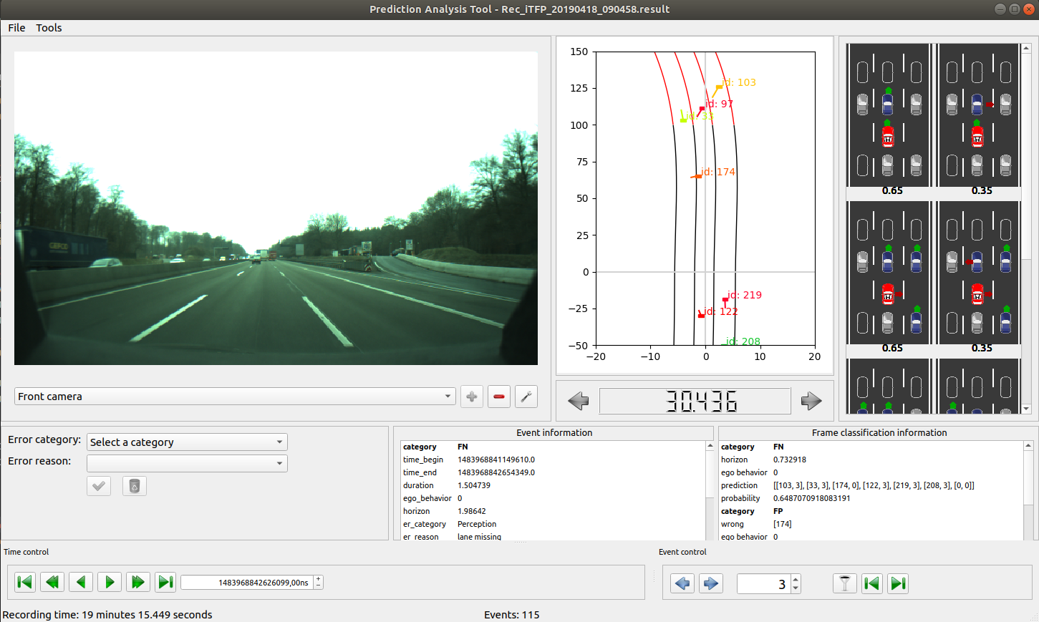

HRI - RINF TECH.
Collaboration Context
RINF.TECH is a technology and engineering company which enables organizations' growth through Digital Transformation.
We bridge the gap between hardware and software, delivering innovative digital products and services.
Since 2017 we completed 30 requests related to 17 projects:
Cooper
Decision Making Support Tool
Prediction Analysis Tool
…
Avatar Framework
Notes:
Presenter: Victor
- Cooper: Tool for visualising 3D mesh deformations in Mixed Reality developed for Sebastian Schmitt and Patricia Wollstadt
- Decision Making Support Tool: Interactive optimisation tool based on genetic algorithms developed for Tobias Rodemann
- Prediction Analysis Tool: Tool for analysing false predictions done by a self driving car developed for Sven Rebhan
- Avatar Framework: Framework for developing web applications that control 3D avatars implemented for Frank Joublin and Antonello Ceravola

Slide 3
Proposal.
ONGOING COLLABORATION (in the past 3 years and running):
Build quality software products out of existing research developments and provide HRI with ongoing programming and QA support
ENHANCING PARTNERSHIP (in addition):
IP acquisition, sharing or licensing agreements that allows marketing to potential customers with acknowledgement of the HRI – RINF cooperation
Jointly apply for third-party funding such as EU projects to support the development of new features and go to market activities
Example: Develop the Avatar Framework as a tool to enhance presentations for novel learning experiences
Notes:
Presenter: Victor
We are most fond of the HRI projects with DeepTech components.

Slide 4
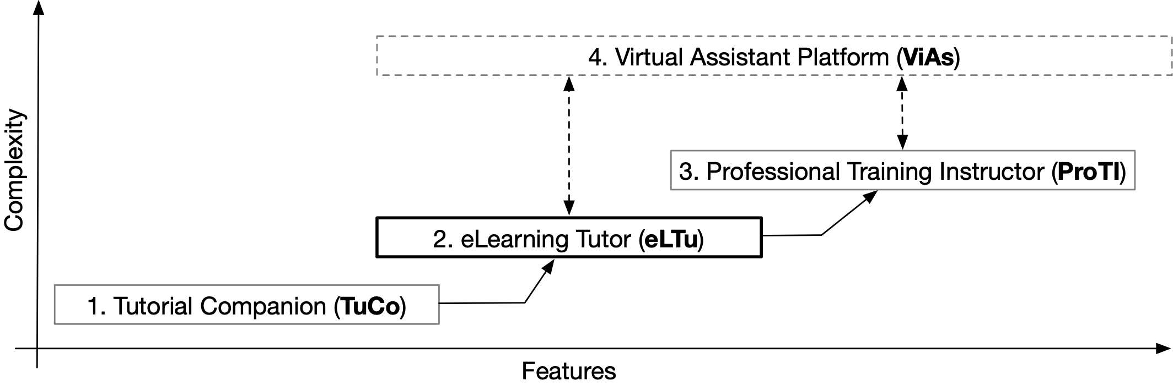
Avatar Framework Development Paths.
Example of a phased development into three stages and a parallel track
Notes:
Presenter: Victor
For the moment the framework is at prototype phase and we can transform it in a product with some consistent work & further research.

Slide 5
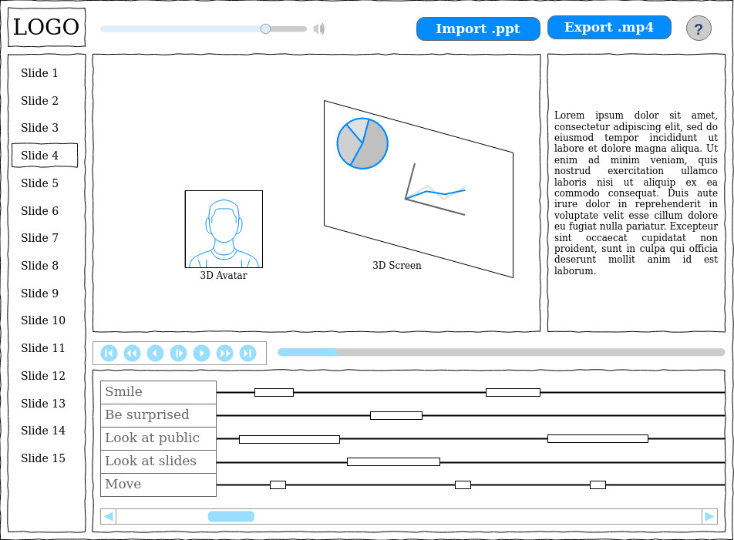
The Tutorial Companion
TuCo.
Overview:
Create lively presentations where an avatar reads a script with gestures and mimics as well as voice inflections derived from meaning and punctuation
Aimed at both professionals and personal users with ROI tool
Monetization as freemium product or a small monthly fee
Technical solution: web tool to generate presentations videos based on predefined scripts/actions
Notes:
Presenter: Andrei

Slide 6
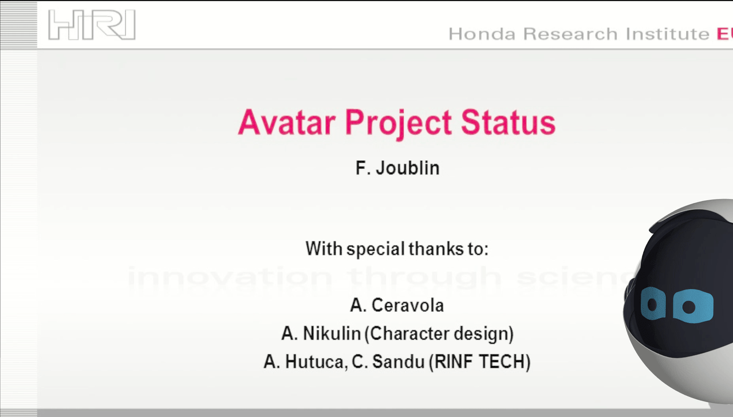
The Tutorial Companion
TuCo.
Benefits for Honda:
Sales, marketing and public relations tool
Use cases
Create attractive and forward-looking presentations for large events in trade shows
Present cars in showrooms, on the web and on mobile devices of customers
Fully tested and supported software product for HRI/Honda and partner use
Notes:
Presenter: Andrei

Slide 7
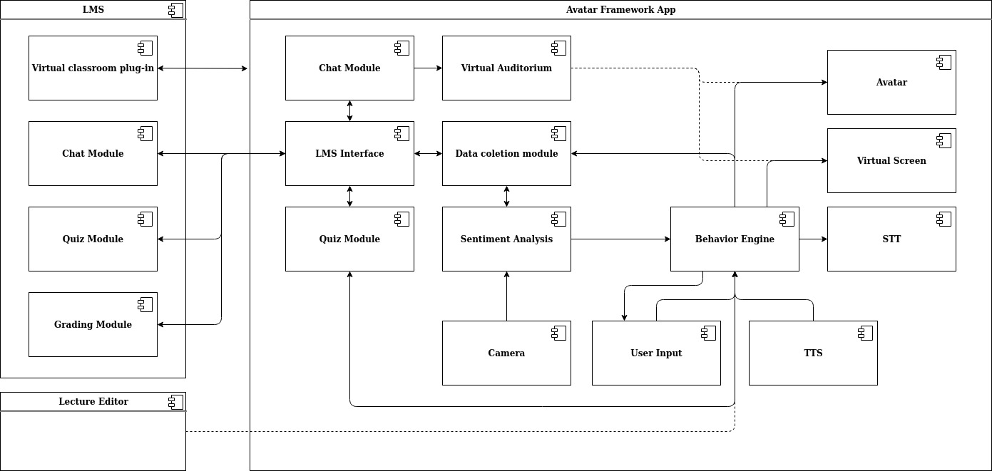
The eLearning Tutor
eLTu.
Overview:
Virtual classroom module for leading LMS platforms (e.g. Moodle, Blackboard)
Drive student engagement with e-learning content
Direct or indirect sales model in a growing market
Technical solution: virtual classroom module for bidirectional integration with leading LMS components
Avatar Framework App
Notes:
Presenter: Grig

Slide 8
The eLearning Tutor
eLTu.
Benefits for Honda:
Deliver e-learning content to sales associates upon new model launches and validate their product knowledge
Accelerate staff training for both technical skills as well as soft skills
Built-in interactivity for increased adoption of the training content and evaluation through quizzes
In-house fully-supported tool that is integrated with current LMS solutions
Notes:
Presenter: Grig

Slide 9
The Professional Training Instructor
ProTI.
Overview:
Support continuous and life-long learning for professional education and retraining
Complement to existing solutions such as Festo Ciros Studio, Automation Studio, Factory I/O
Sales model based on customized industry-specific packages and support/customization ongoing services agreement
Benefits for Honda:
In-depth trainings and upskilling for service technicians on automobile digital twins
Support academic partnerships for initial training of future employees
Notes:
Presenter: Victor

Slide 10
The Virtual Assistant Platform
ViAs.
Overview:
Dedicated platform for the design and development of virtual assistants based on the Avatar Framework – as a stand alone CMS
Target industries: communication and interactions for call centres & BPO, eLearning & training, healthcare, pharma, manufacturing and industry 4.0
Components:
Avatar Framework, Advanced options for algorithm tuning, Developer specific customizations, Avatar template library
Monetization:
Usage tiers and advanced features
Use cases for Honda:
Meisy as an in-car assistant e.g. easy retrieval of information from the user manual
Holographic Customer facing sales tool for car dealers e.g. avatar booth for an engaging presentation of the main car features
Notes:
Presenter: Victor

Slide 11
Business Model.
Establish a joint-venture between HRI and RINF that allows IP acquisition, sharing or IP licensing for research outputs developed by HRI, to be transitioned into fully-fledged products by RINF
HRI and Honda to benefit from all developments of the product and unlimited use
HRI to access RINF expertise and technical know-how for software development
RINF to benefit from the latest research by HRI. HRI able to influence product roadmap
RINF may call on HRI for consultancy activities in connection to existing products
Example: Continued maintenance and support by RINF of the Avatar Framework in-line with new developments in artificial intelligence, natural language processing and system integration
Notes:
Presenter: Victor

Slide 12
Roadmap Milestones.
Use of the Avatar Framework with minimal modifications as a tag-on in deals with existing customers and marketing towards new customers
Identify other HRI projects that can be transitioned from POC to a product stage
Recurring revenue to support ongoing development and potential to jointly apply for third-party funding
Raise the TRL of the Avatar Framework to TRL 5-6 in order to be eligible for larger EU funding calls for innovation
Accelerated development in the case of identifying a suitable customer
Notes:
Presenter: Victor

Slide 13
Other Supporting Documentation.
Proposals for our client portfolio
Avatar as a Product – research document
Avatar Framework – areas of improvement
TuCo Minimum Viable Product – effort estimation
Notes:
Presenter: Victor

Slide 14







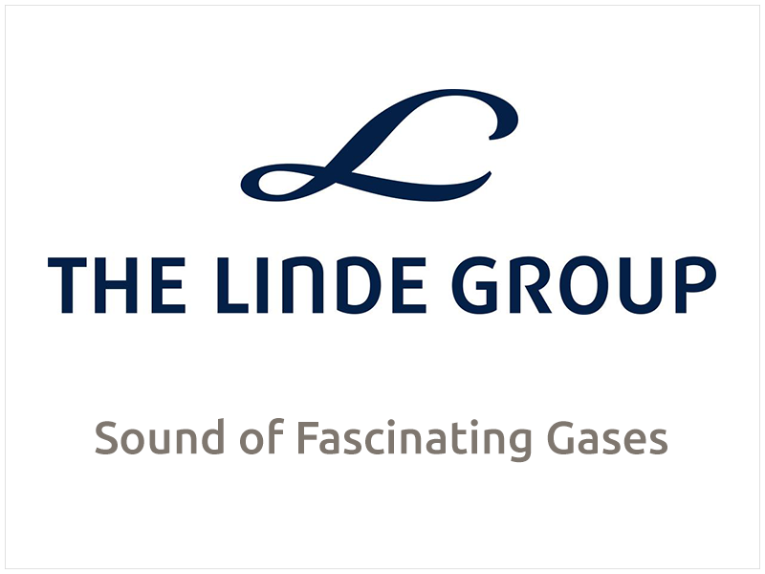











Clients which may be interested in avatar products.

Slide 15
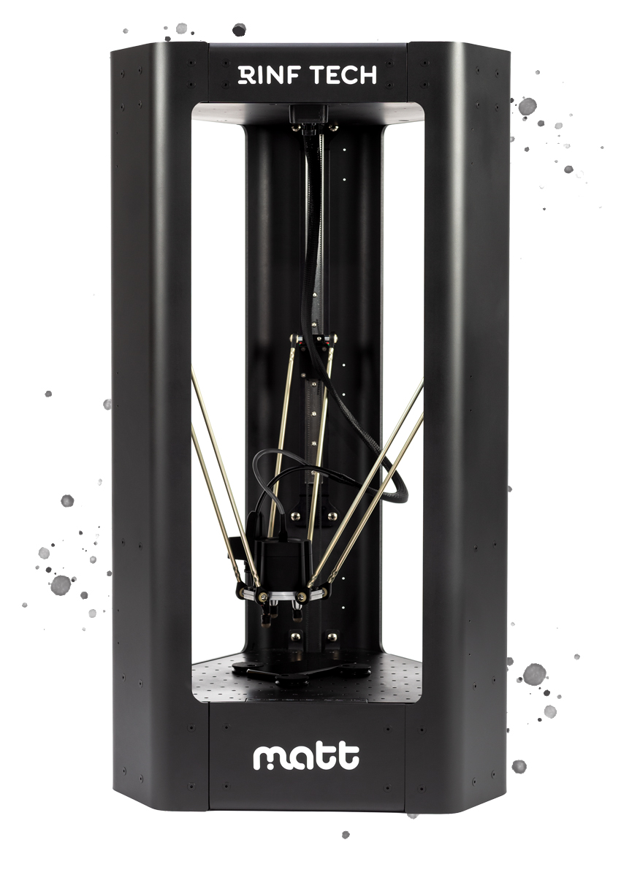
Project Experience.
Market Launch of an Innovative System for Touch-screen Devices Application Testing - MATT
Product: Delta-type robotic platform with on-board computer vision to automate mobile app testing
~200k EUR, EU Funds through the Competitiveness Operational Programme
https://www.mattrobot.ai

Slide 16

Thank you!
www.rinftech.com

